Slide 1
Introduction to Computing for Data Analysis
Compression via PCA+SVD
Richard Vuduc, Ph.D.
Associate Professor
School of Computational Science and Engineering
Projections
Notes:
Hi there, it’s great to have you back.
So as we gear up to compress our data, I wanted to start with a “first principle” – spelled with an “ell-ee” -- namely, the idea of a principal (with an “ay-ell”) component.
As usual, let’s start with an intuitive idea and then try to make it more mathematically precise.

Slide 2
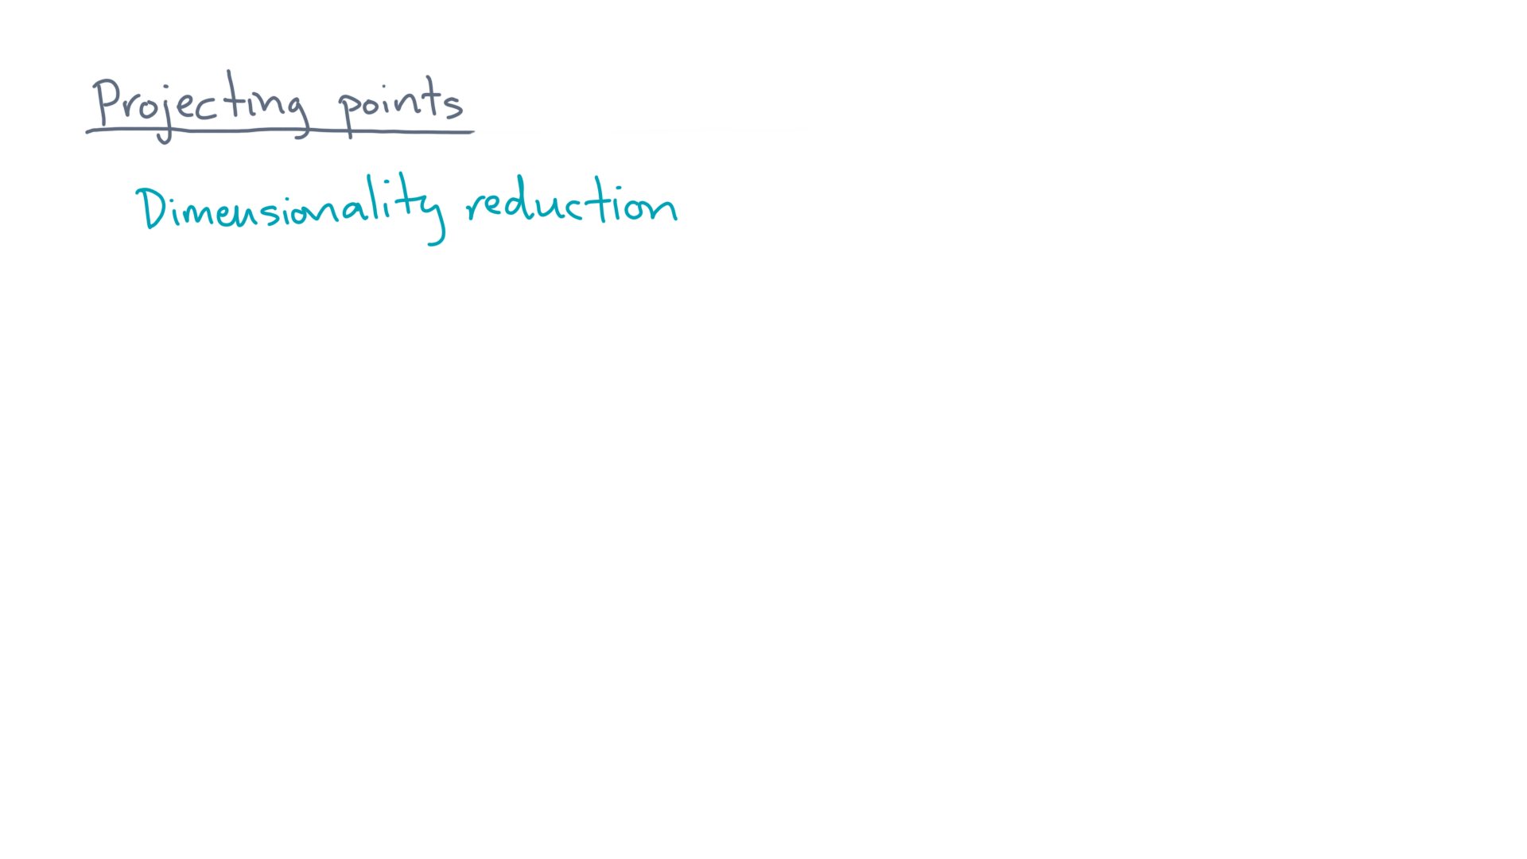
Notes:
One way to think of compression is the idea of “dimensionality reduction.” @SHOW/WRITE “Dimensionality reduction:”
That means going from a some number of dimensions to some lower number.

Slide 3
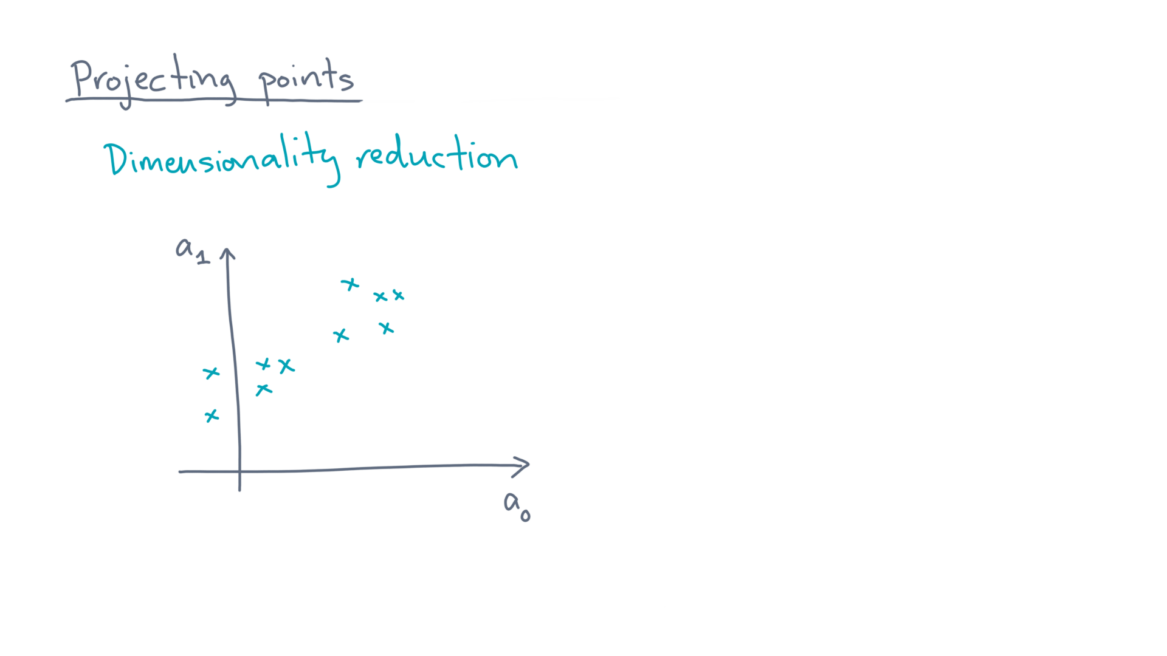
Notes:
For instance, consider this set of two dimensional points. @TODO: Show points

Slide 4
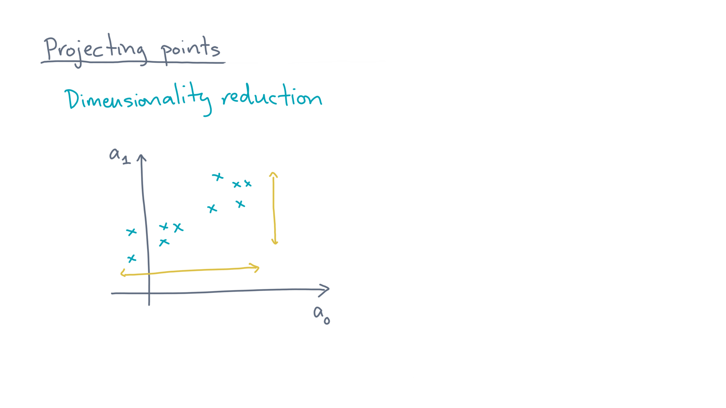
Notes:
Notice that there is variation in both dimensions. @TODO: Highlight extents along x- and y-axes.

Slide 5
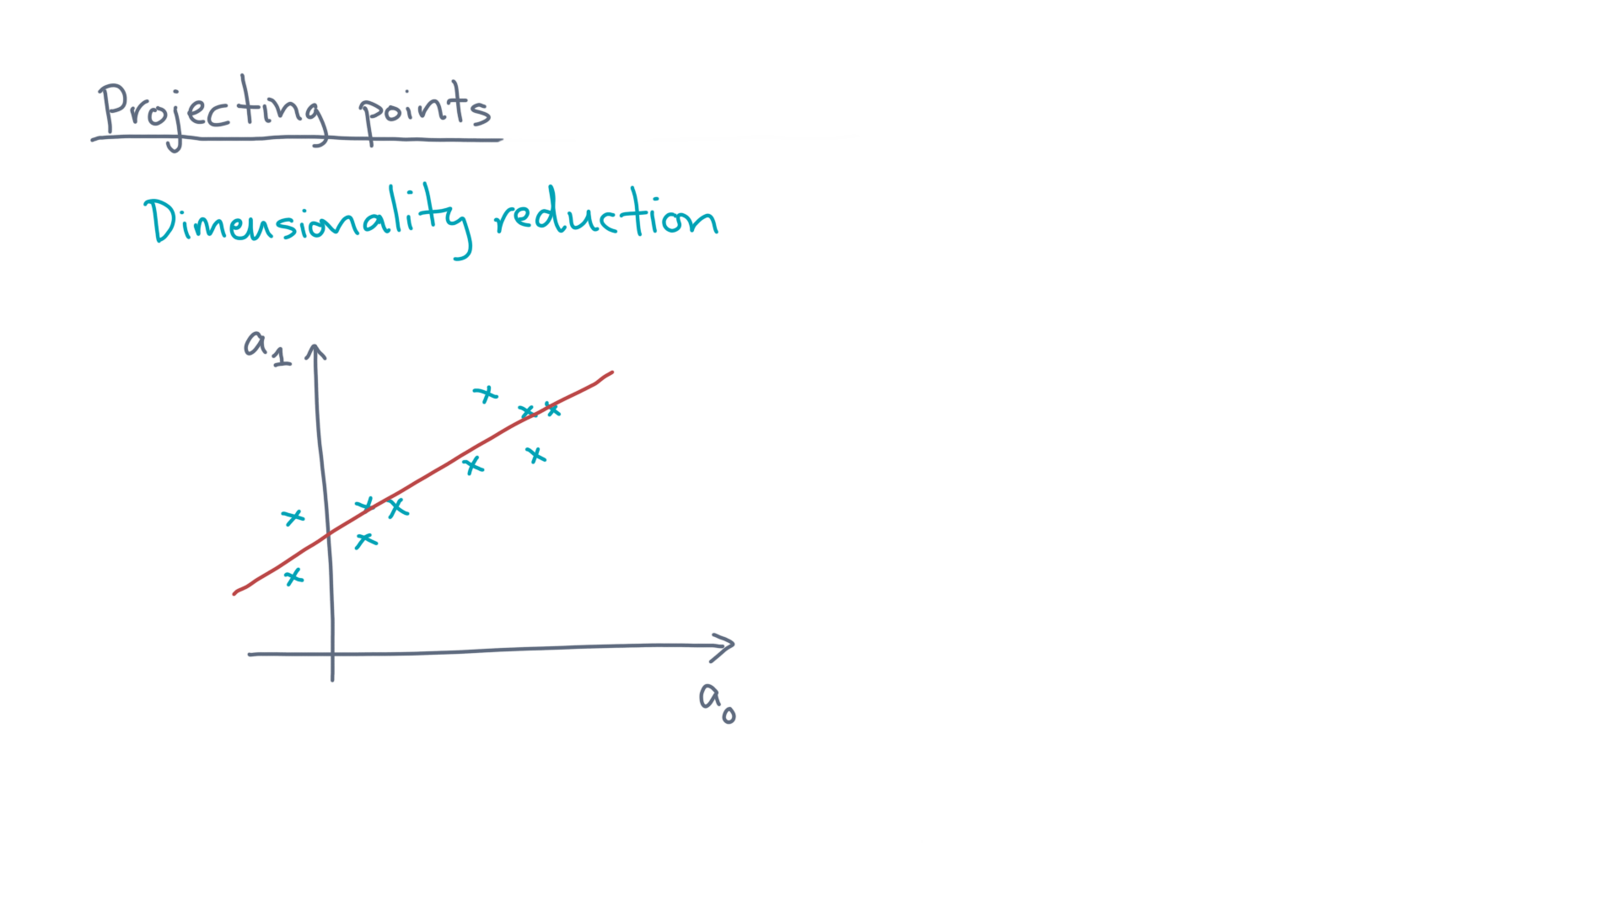
Notes:
However, as you might conclude if you were doing linear regression, it also looks like a *line* might also be a good approximation to these data. @TODO: Draw line
So what would this approximation look like?

Slide 6
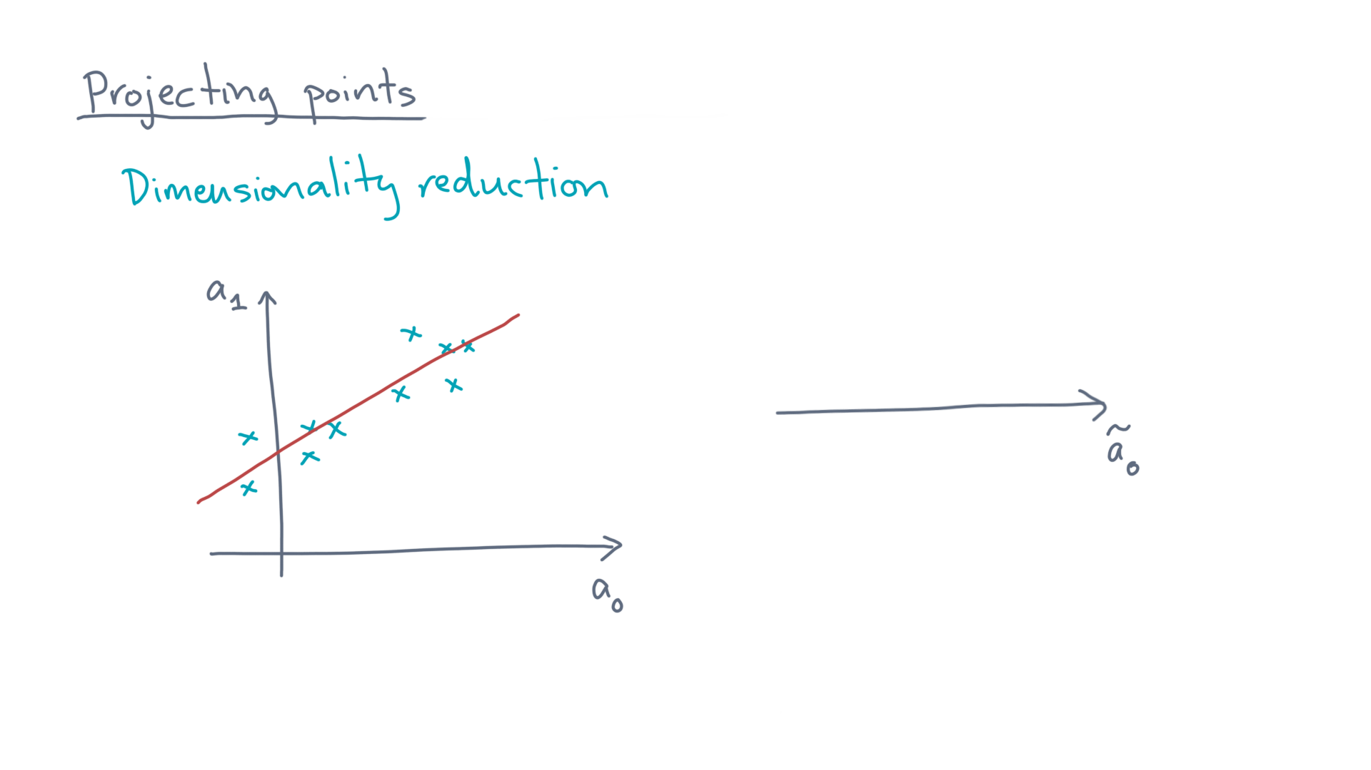
Notes:
Let’s imagine a new lower-dimensional representation. @TODO: Draw number line named x’_0
In this case, that’s a single axis in a one-dimensional space.

Slide 7
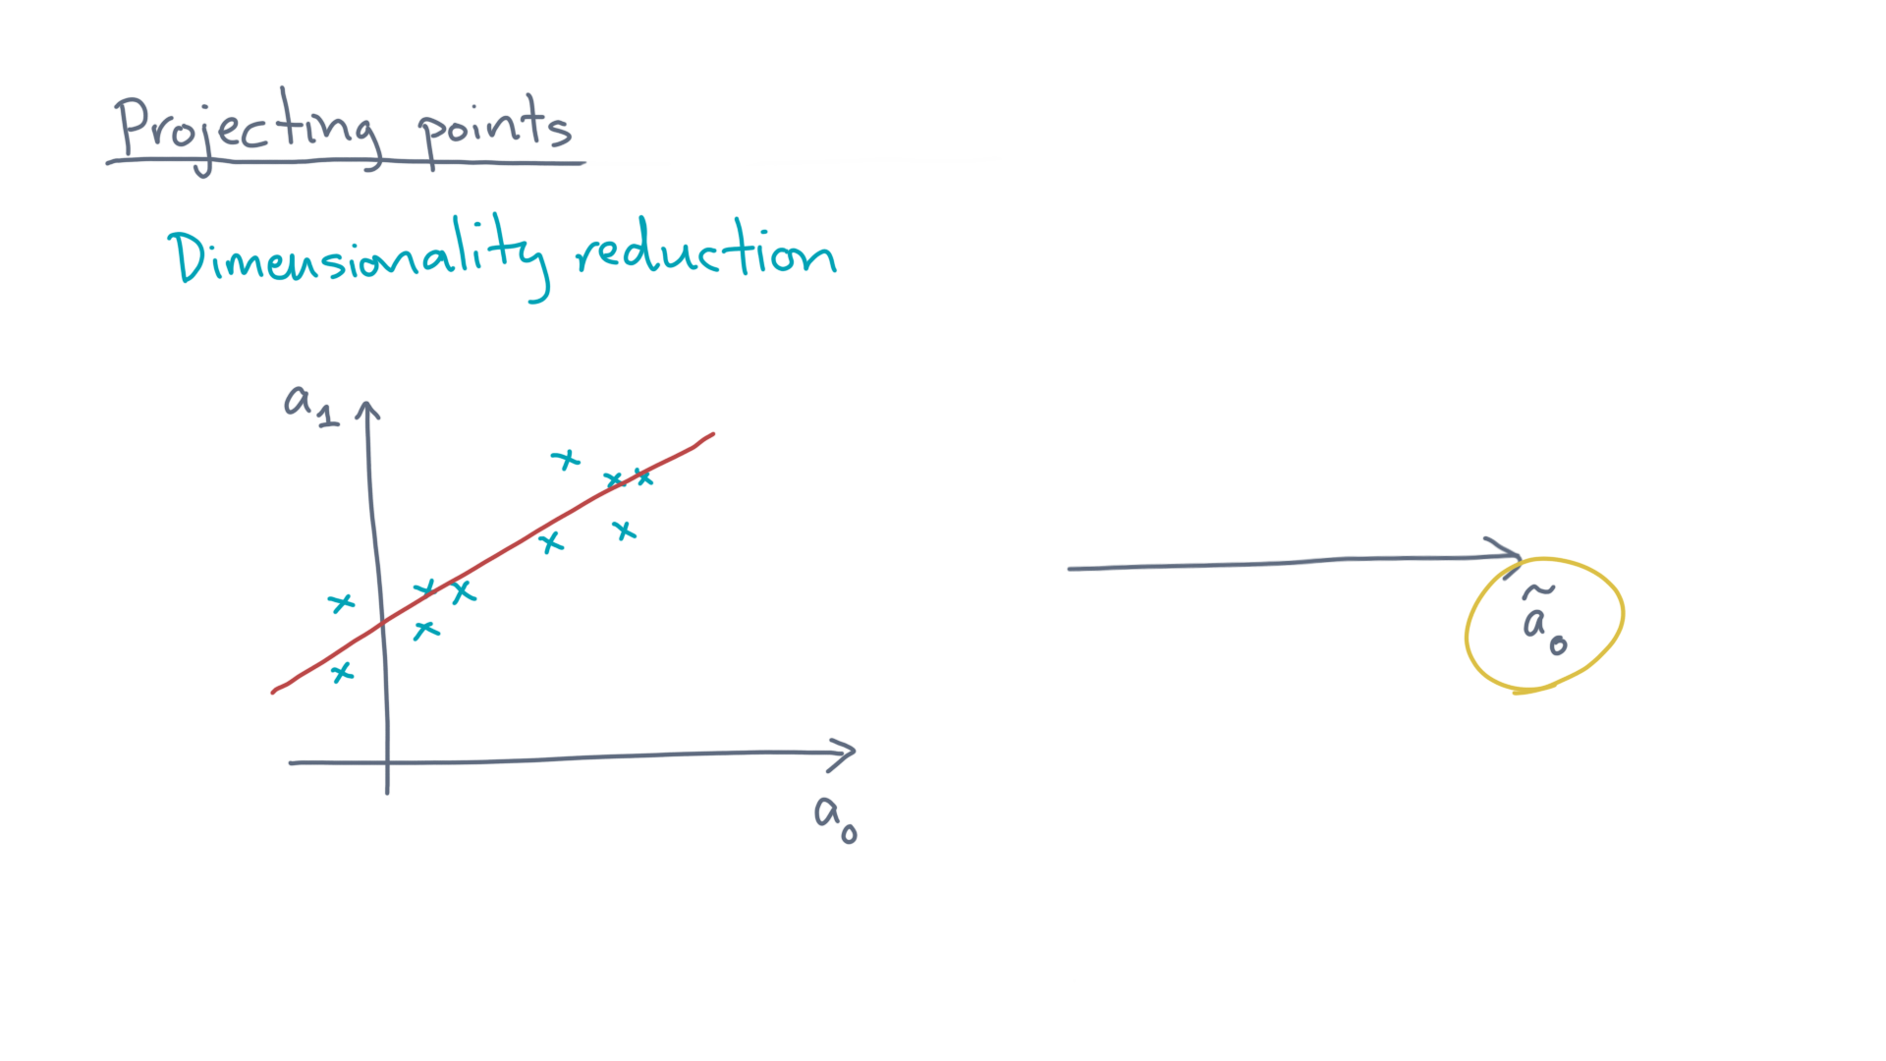
Notes:
Let’s name that axis, “a-zero twiddle.” @TODO: Highlight \tilde{x}_0

Slide 8
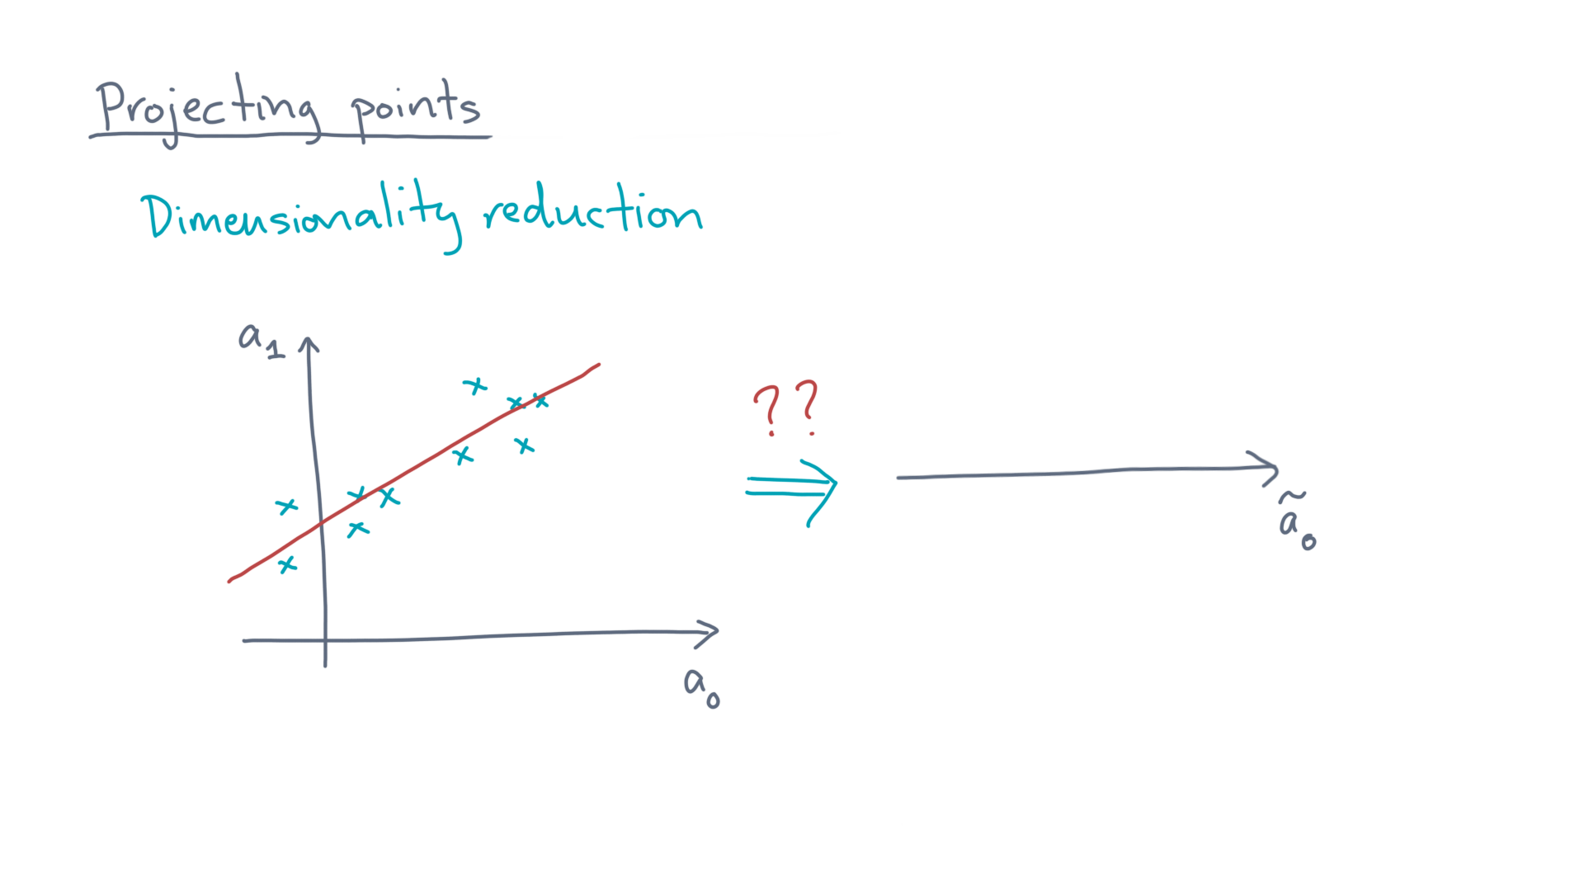
Notes:
Now, we have to map each original point to this new axis. @TODO: Draw arrow with question mark over it

Slide 9
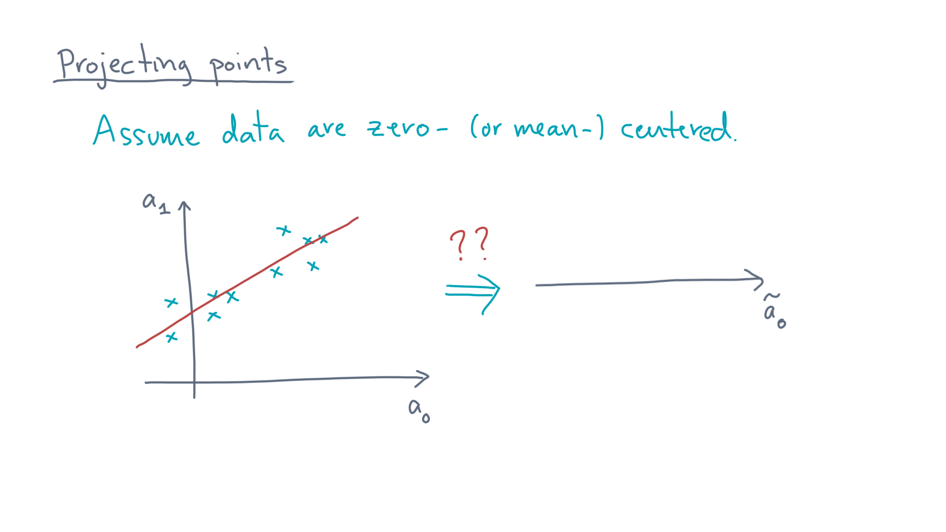
Notes:
First, let’s assume the data are zero-centered. @TODO: Write zero-centered

Slide 10
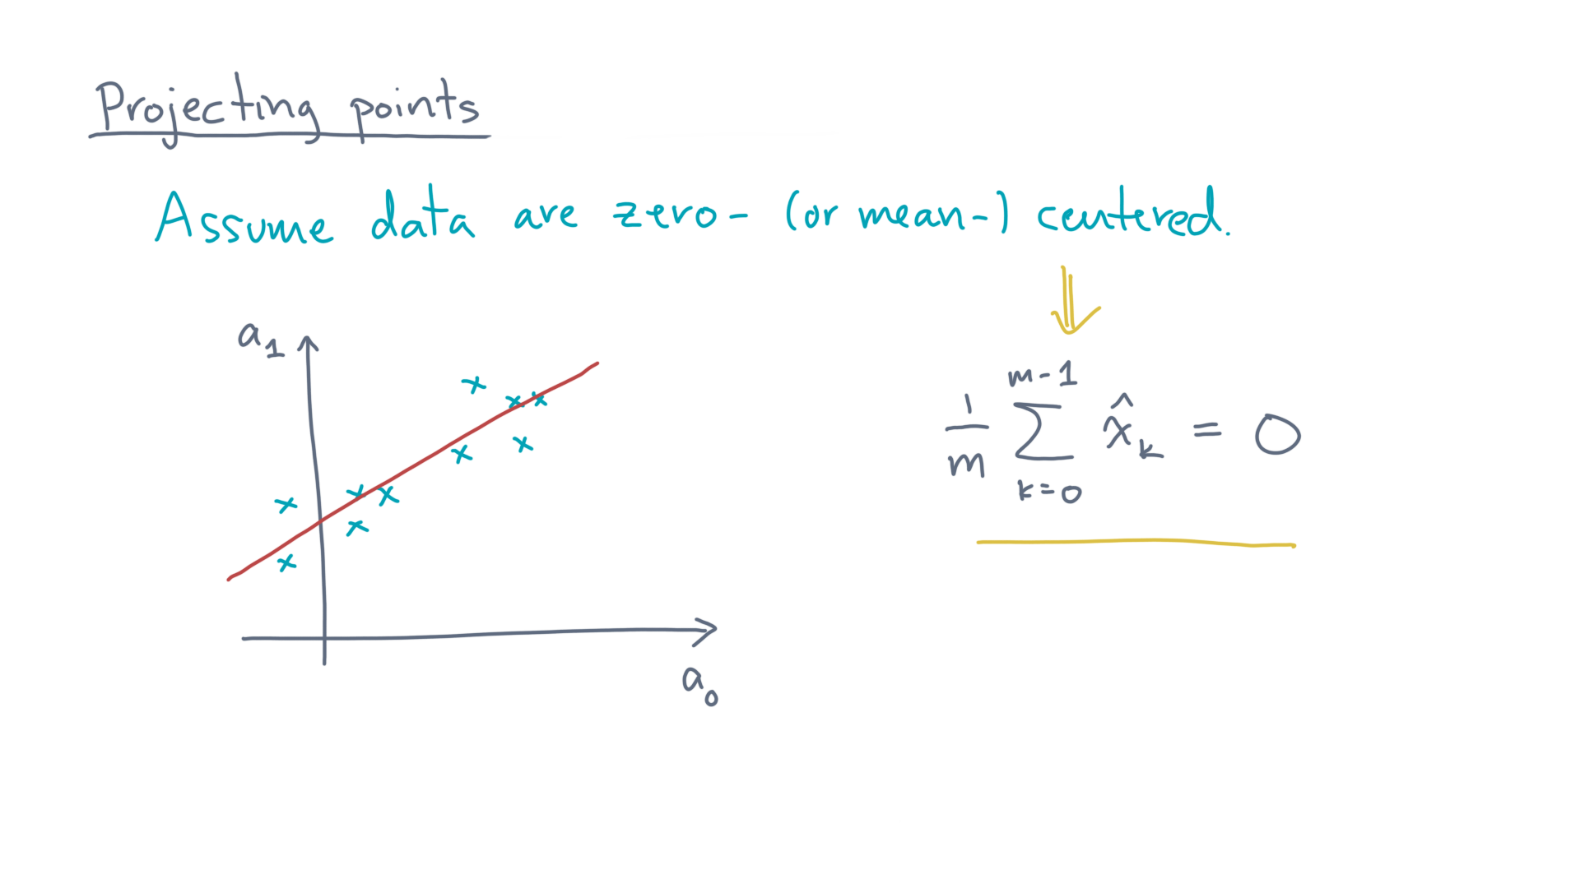
Notes:
That is, the mean of the m data points, x-hat-zero through m minus one, is zero. @TODO: Write formula
If that’s not the case, then *re-center* the data.

Slide 11
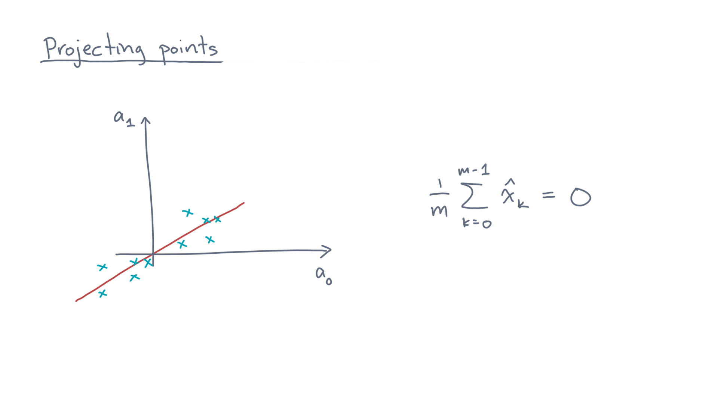
Notes:
@TODO: Show centered data
Why center?
Well, if you make an analogy to linear regression, this intuitive “line” now runs through the origin.

Slide 12
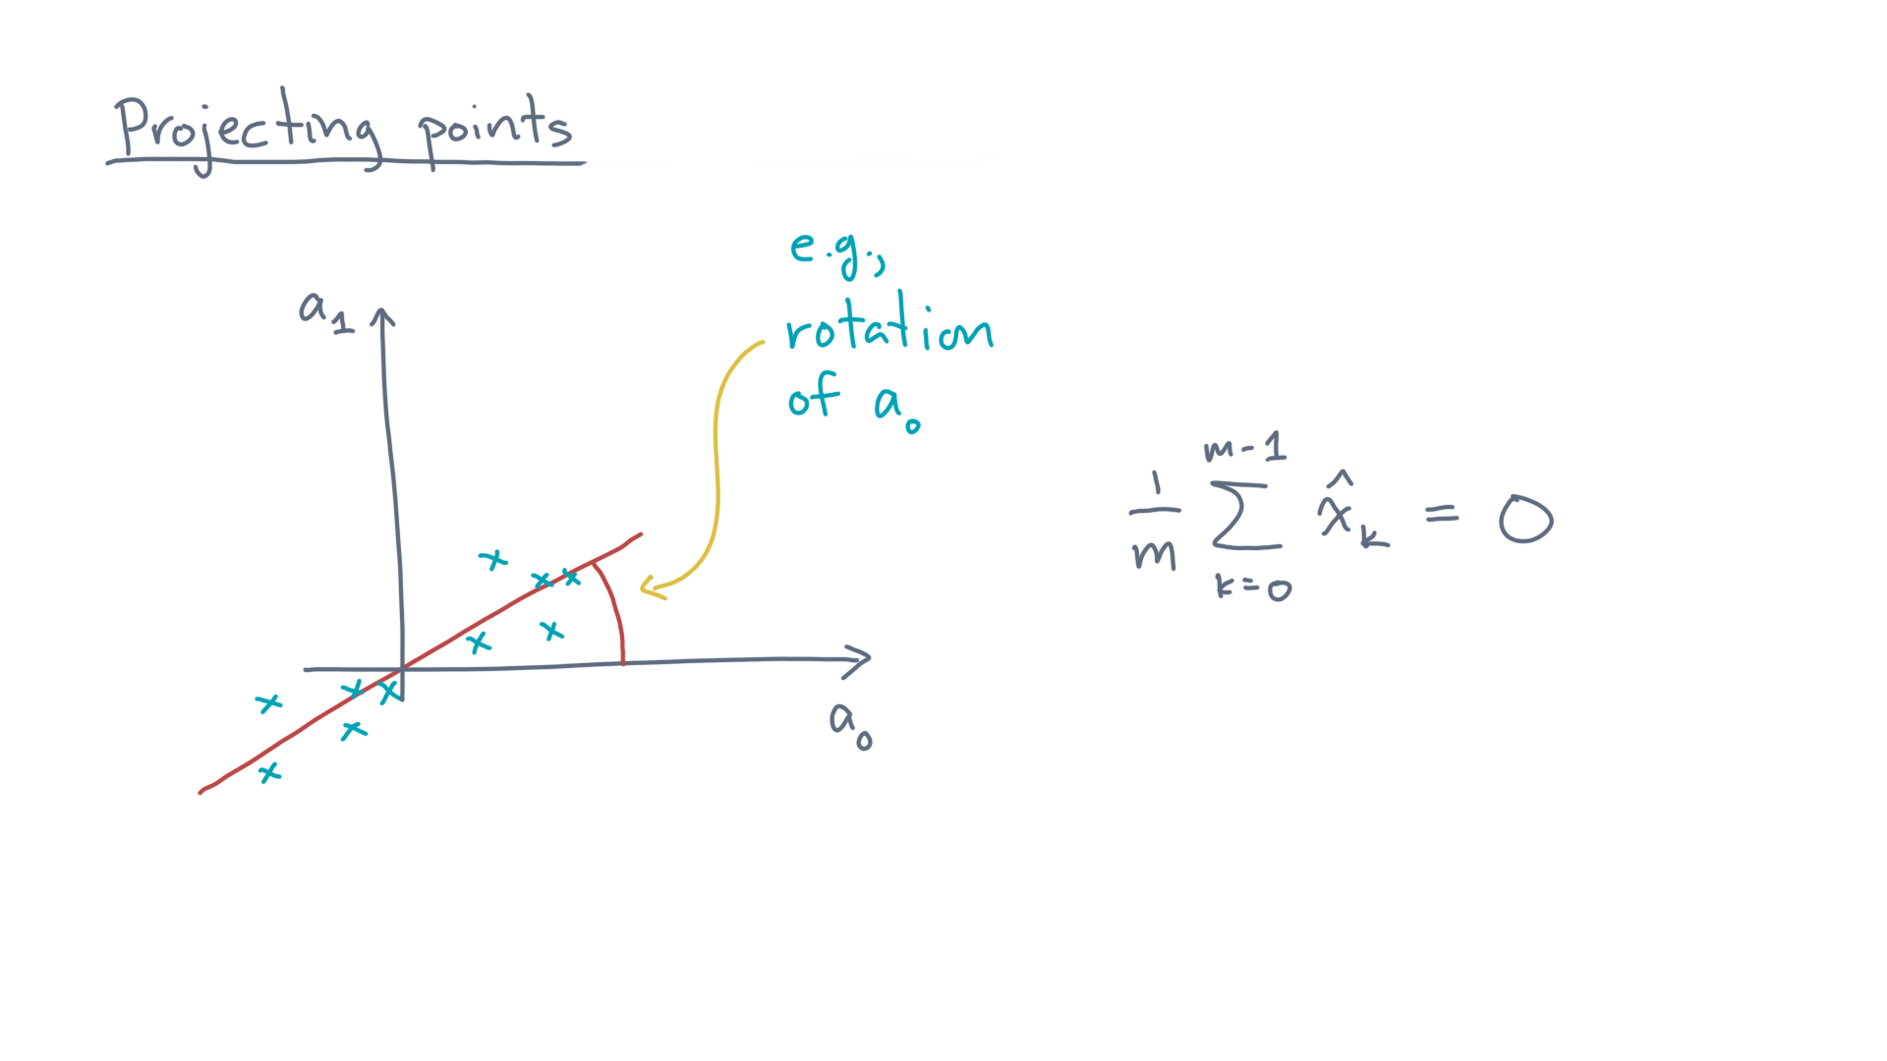
Notes:
@TODO: Show rotation angle
So it’s just like a new axis that you could treat as a rotation of one of the original axes.

Slide 13
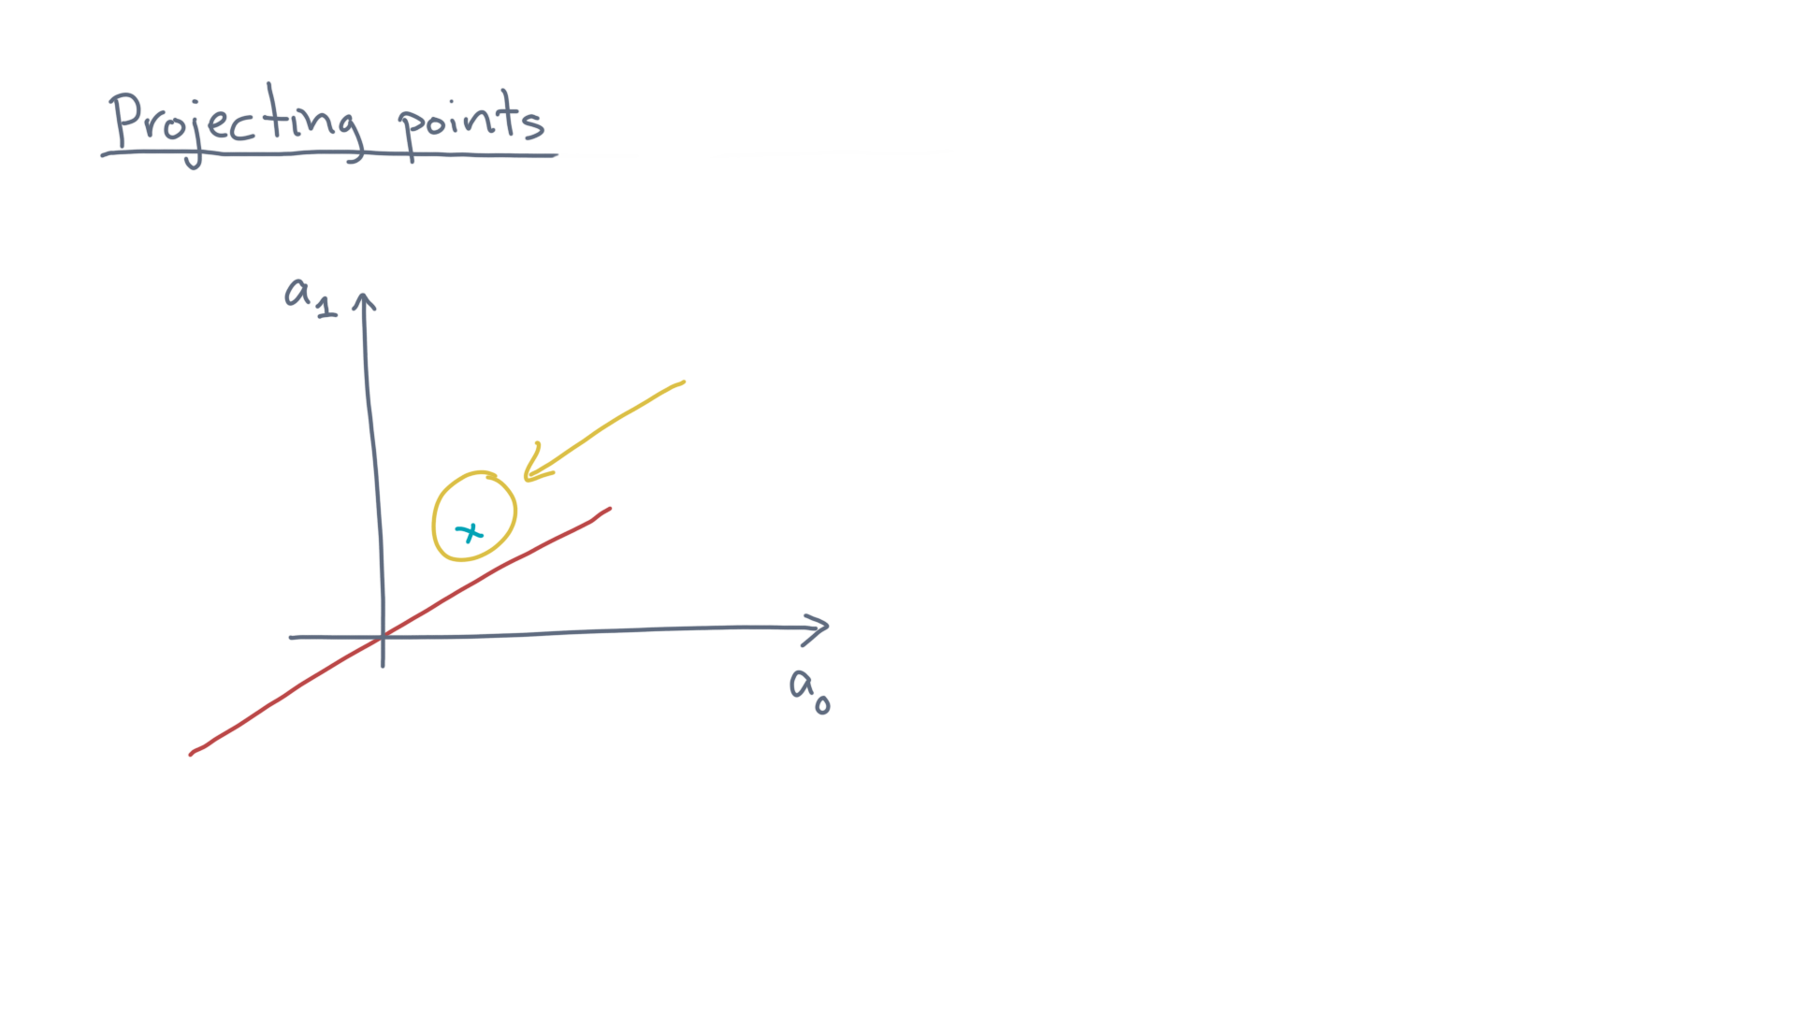
Notes:
Now let’s focus on one of these points, relative to this axis. @TODO: Show point

Slide 14
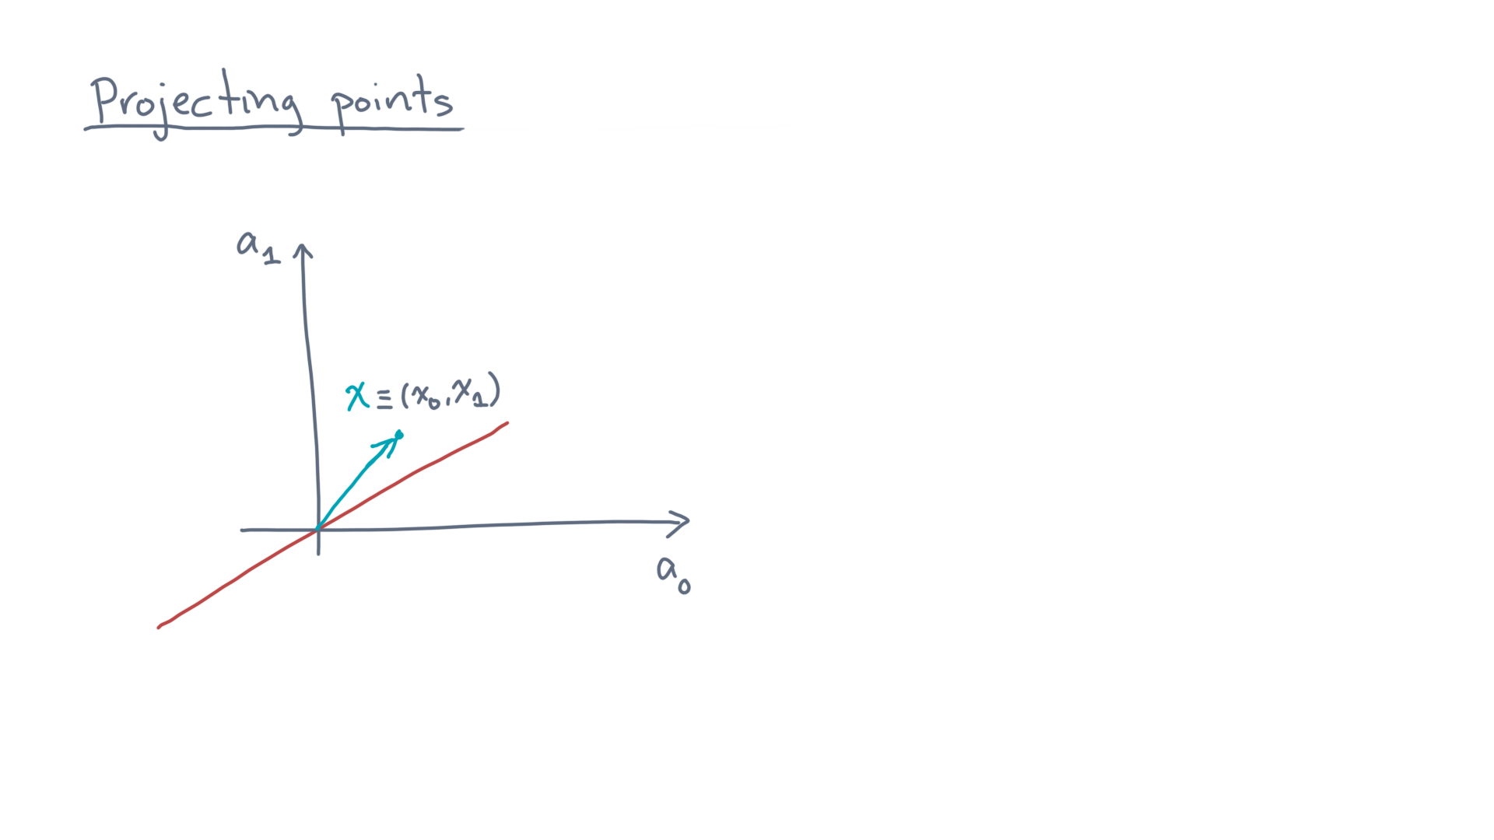
Notes:
We can treat it as a vector whose components are the point’s coordinates. @TODO: Show arrow to point

Slide 15
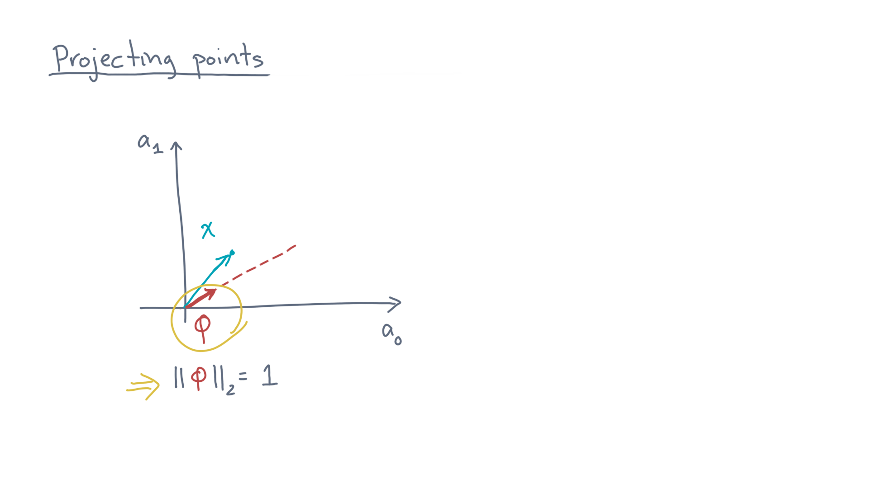
Notes:
Let’s also represent this target axis by a unit vector. @TODO: Show unit vector and highlight
That is, a vector along the line whose length is one.

Slide 16
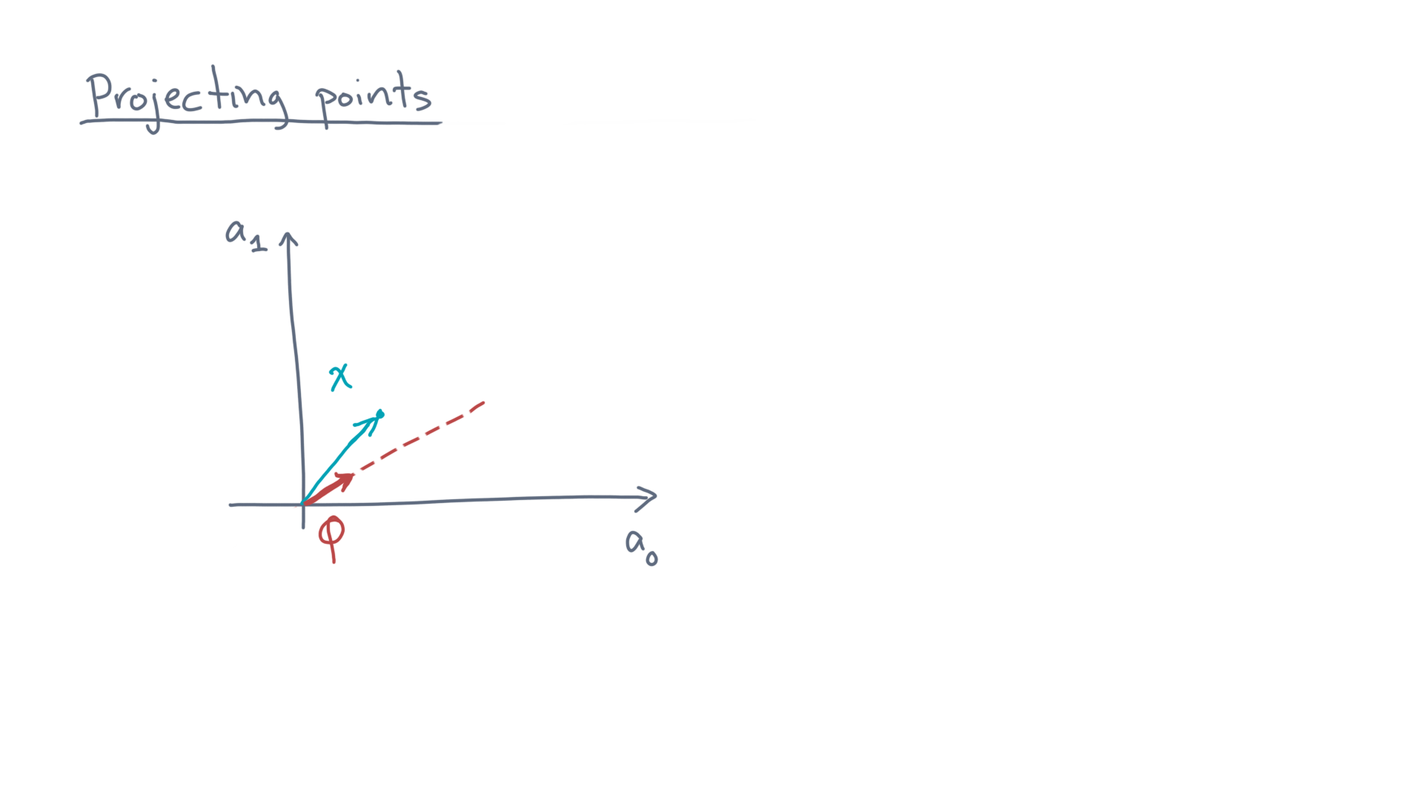
Notes:
Now, we need to map the point to this axis somehow. @TODO: Un-highlight everything.
Here’s one idea.

Slide 17
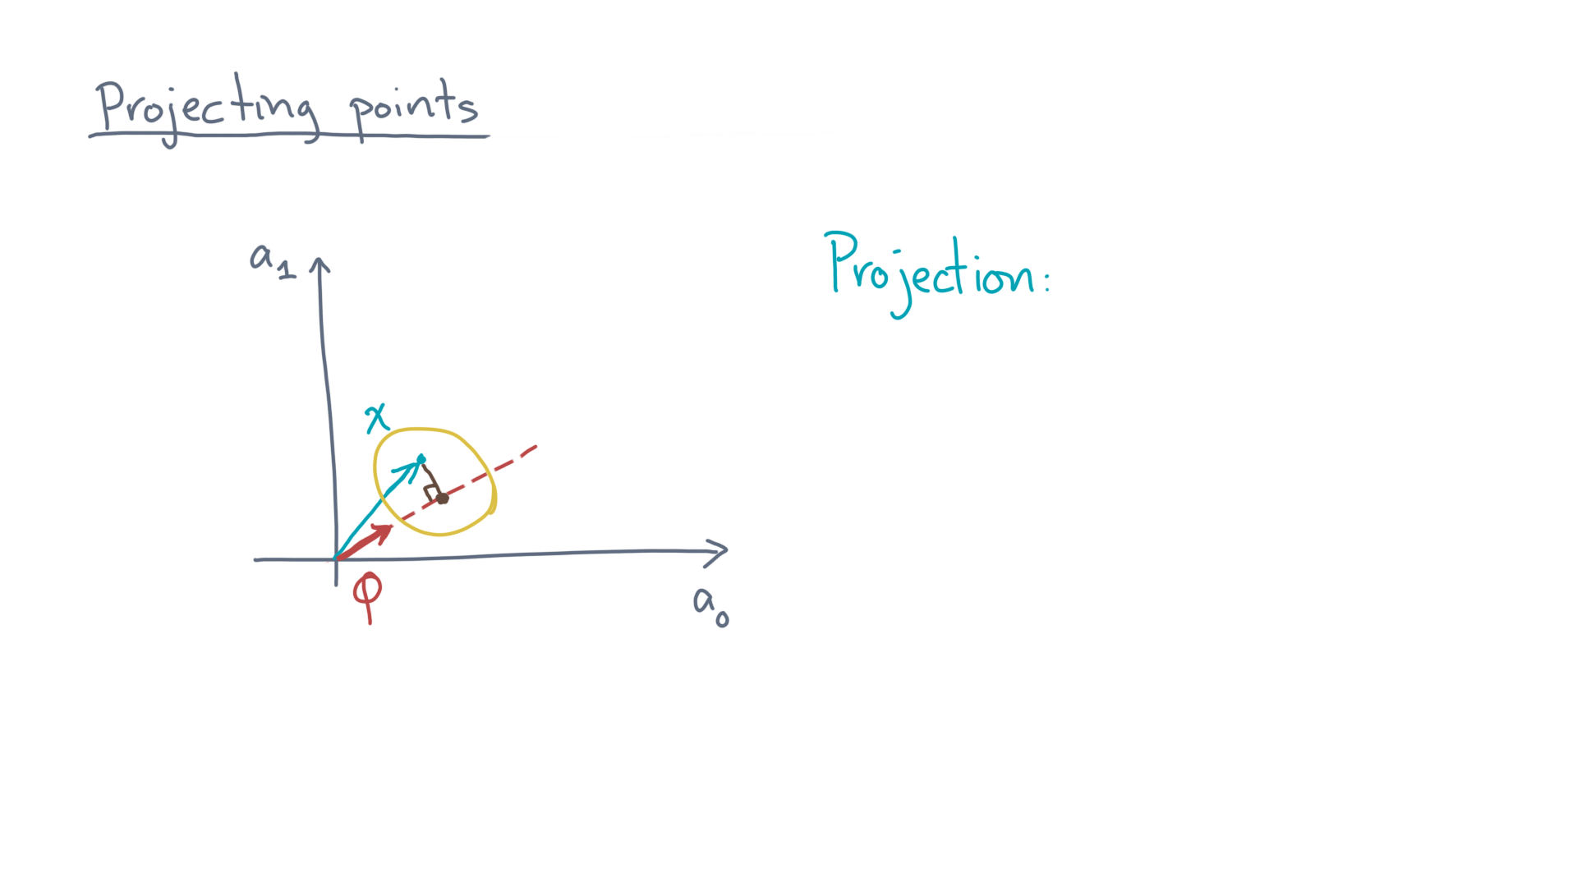
Notes:
Let’s orthogonally project the point to the line. @TODO: Draw orthogonal projection, write “Projection:”

Slide 18
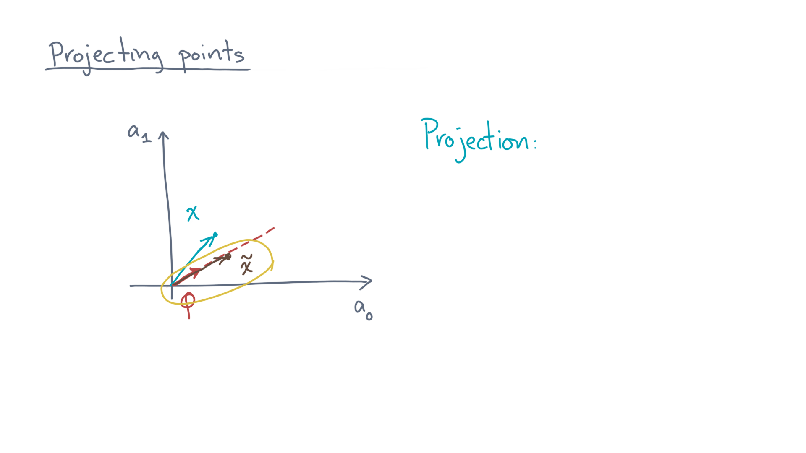
Notes:
This projected point is also a vector. @TODO: Draw vector & label
Let’s call it “x-twiddle.”

Slide 19
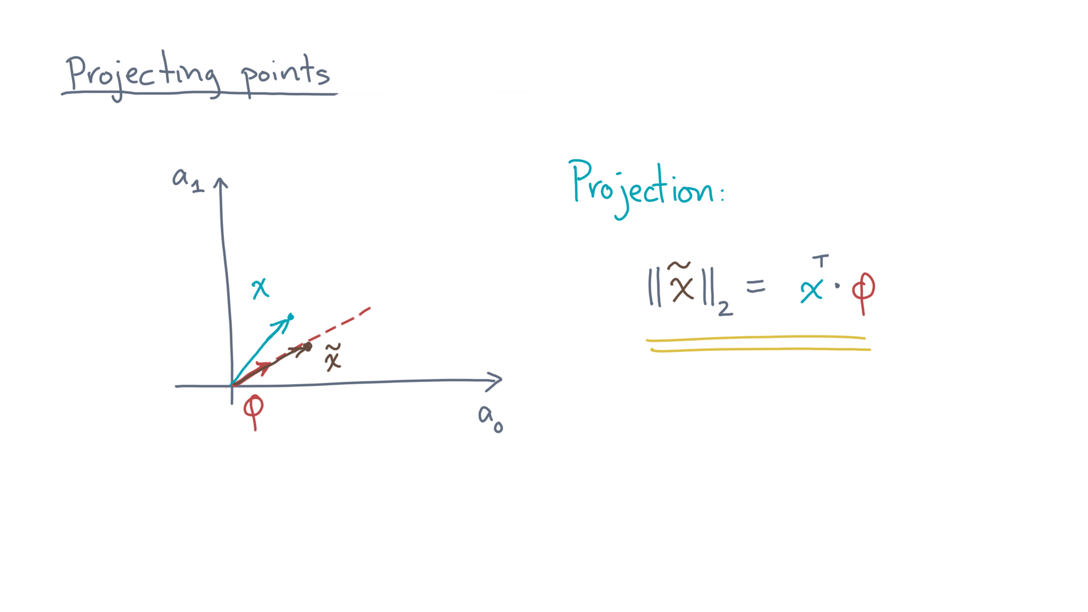
Notes:
Mathematically, x-twiddle-transpose times a-hat-zero is the length of this projection. @TODO: Write formula

Slide 20

Notes:
Let’s return to the original example. @TODO: Show

Slide 21
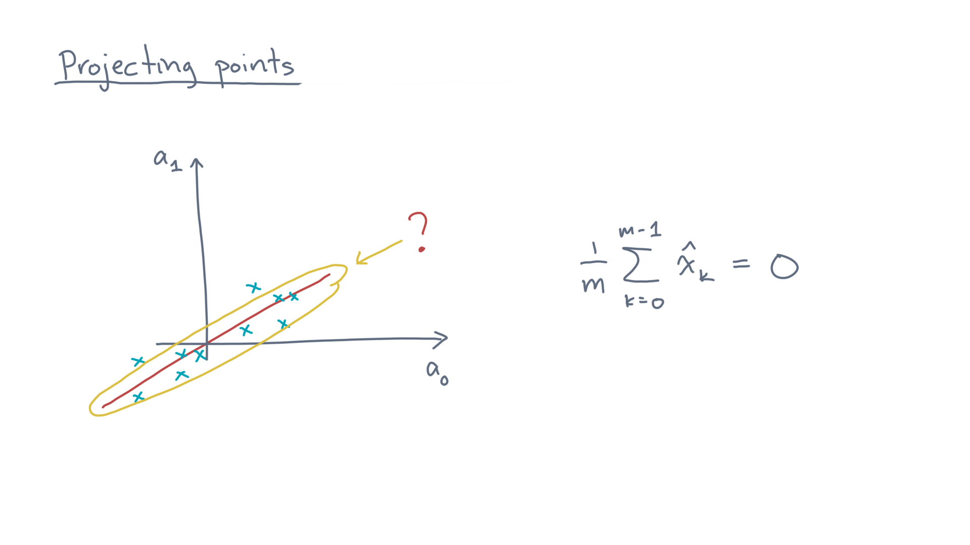
Notes:
How should we select this axis? @TODO: Highlight axis
Here’s one idea.

Slide 22
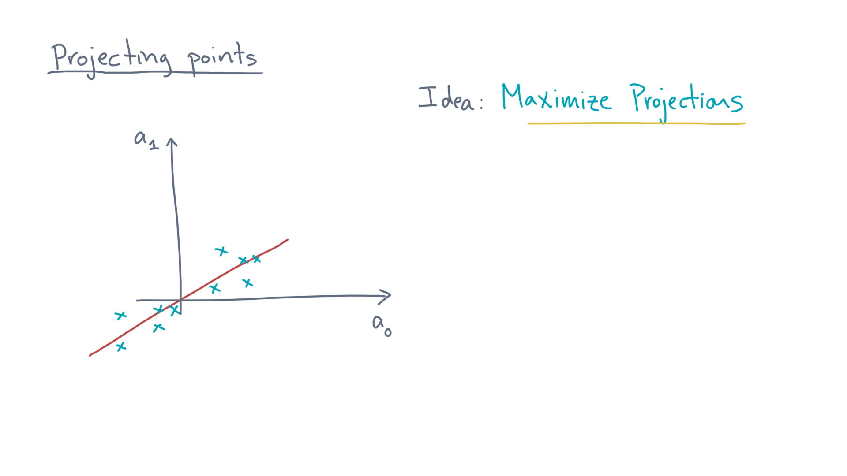
Notes:
Let’s try to *maximize* the projections. @TODO: Goal: Maximize projections
Intuitively, the idea is that whatever axis we choose, it should try to preserve the lengths of the original vectors.

Slide 23
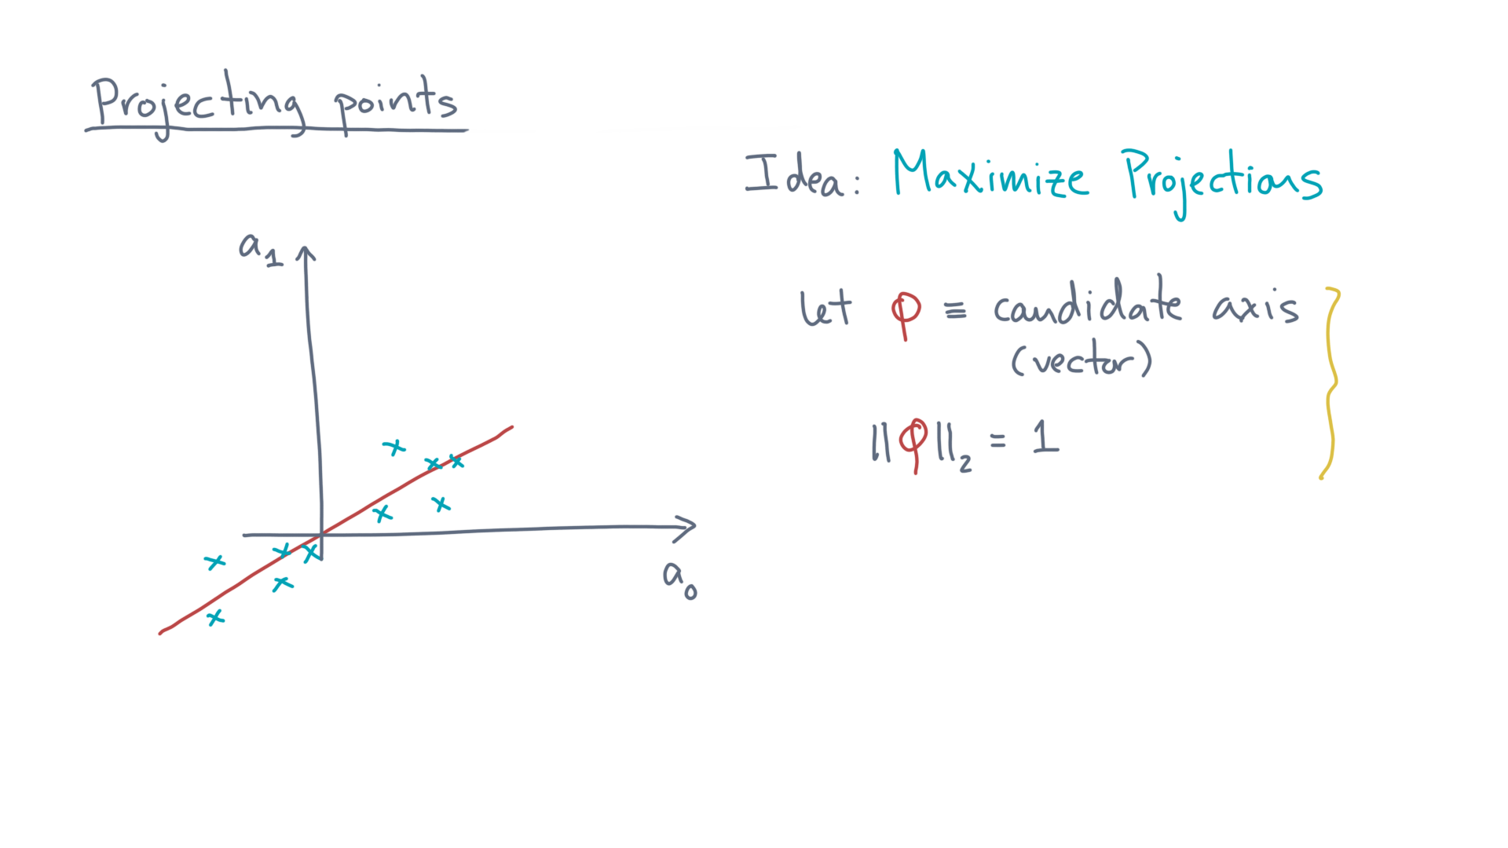
Notes:
In particular, let phi be a unit vector representing a candidate axis. @TODO: Let ||\phi||_2^2 = 1

Slide 24
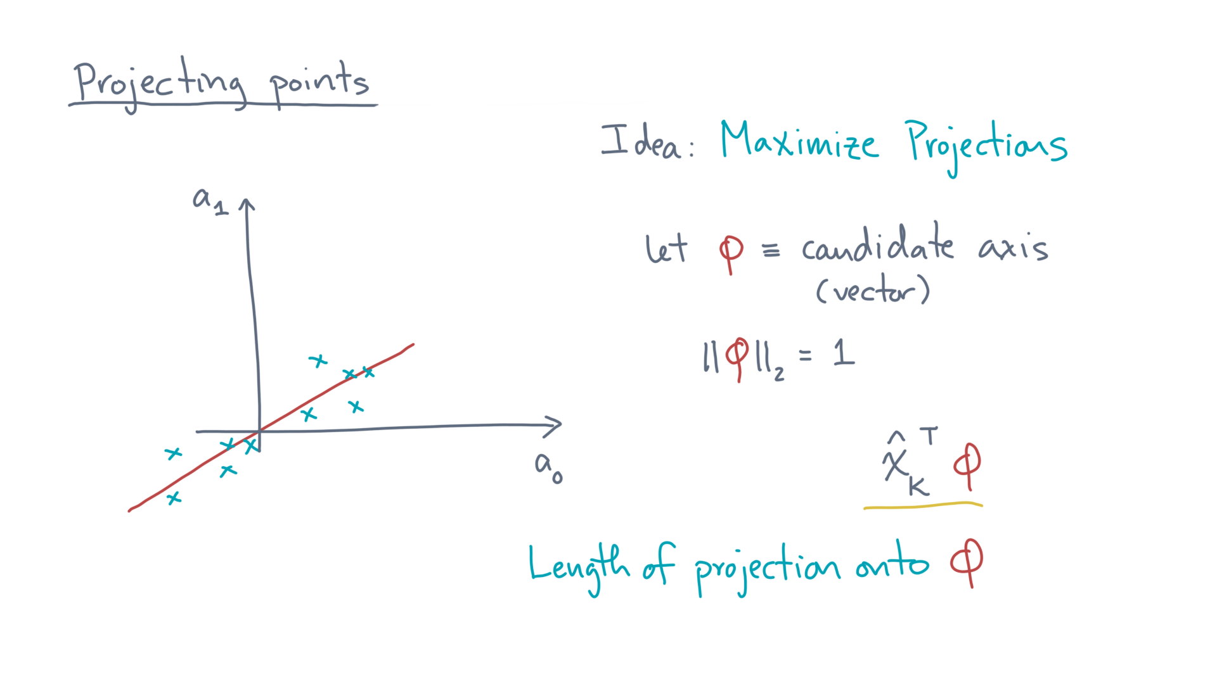
Notes:
Then, for any vector x-hat-k, the length of its projection onto phi is x-hat-k-transpose times phi. @TODO: Show subexpression.

Slide 25
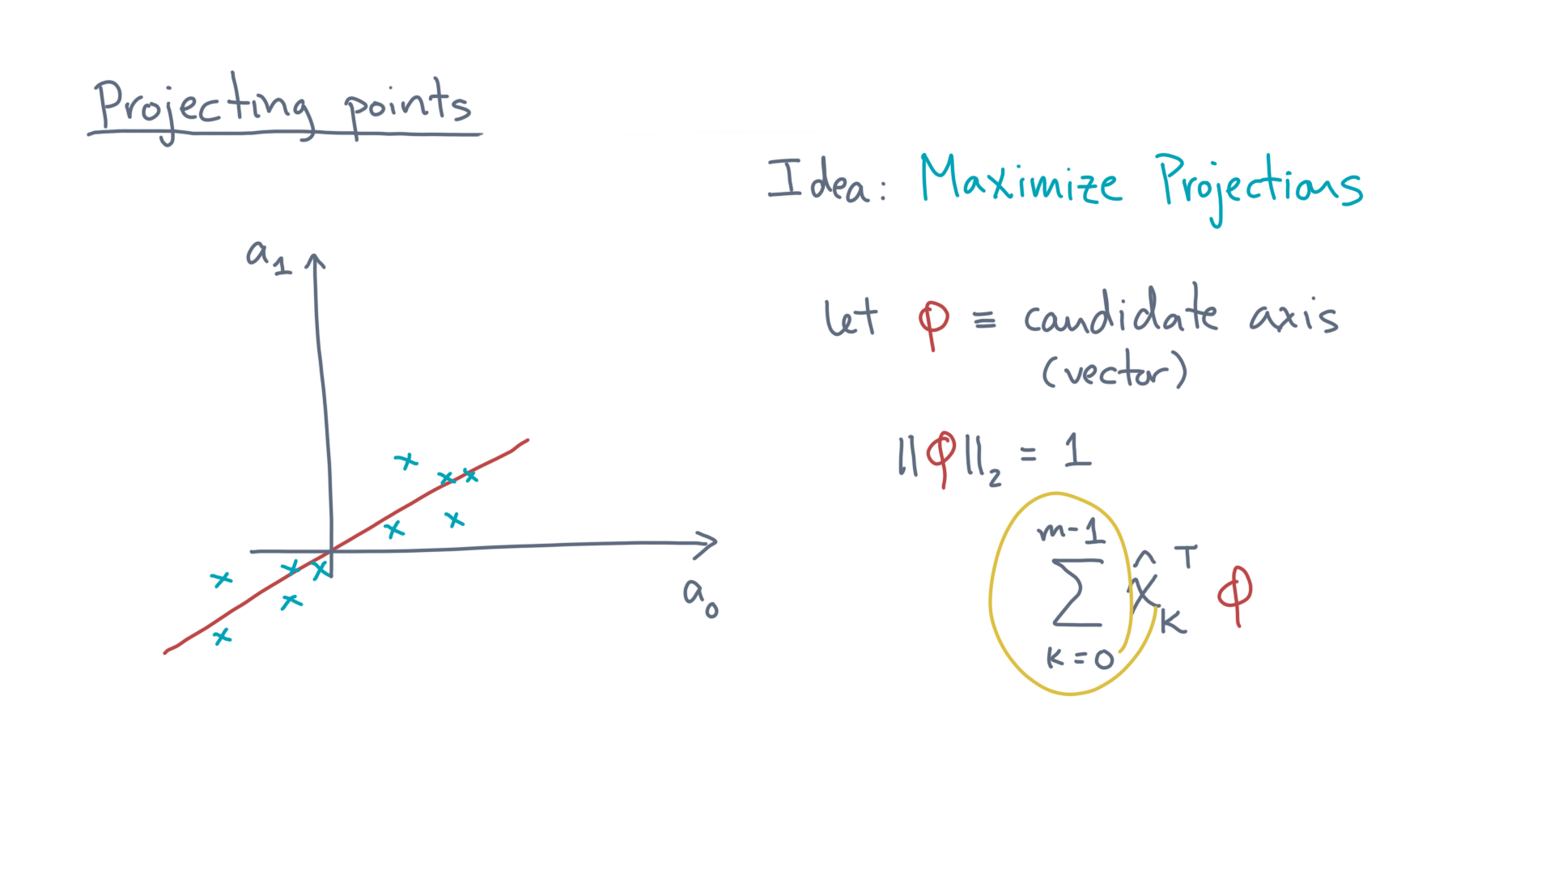
Notes:
A natural objective function is to sum these. @TODO: Show formula

Slide 26
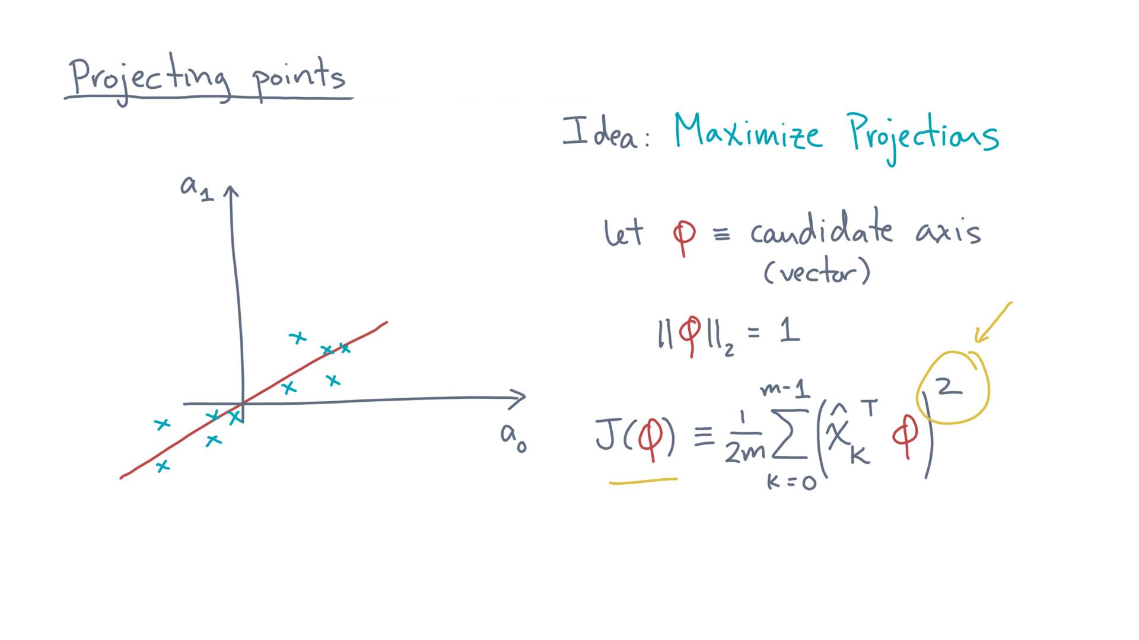
Notes:
Here, the function J(phi) sums the squared projections. @TODO: Highlight square
Doing so makes the math work out a little more easily, just as the sum-of-squared residuals did in regression.

Slide 27
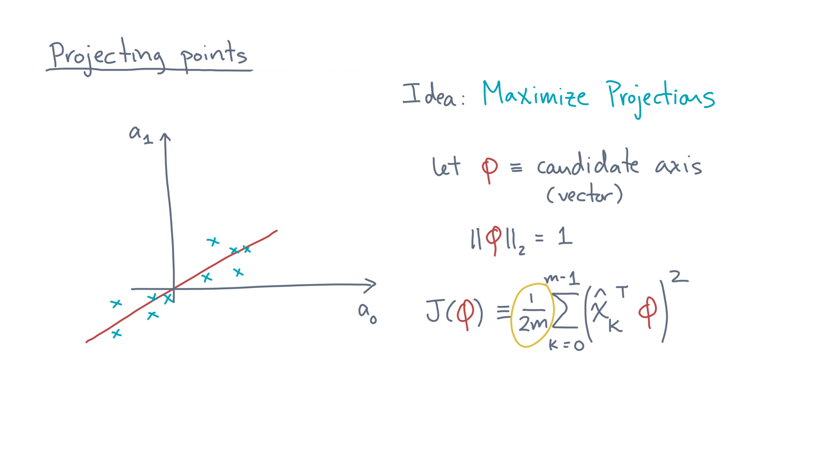
Notes:
In addition, you may have noticed this funny one-over-two-em factor out front. @TODO: Highlight factor
That makes the objective one-half the *mean* squared projections.
It’s done for aesthetic reasons, as you’ll see in a bit.

Slide 28
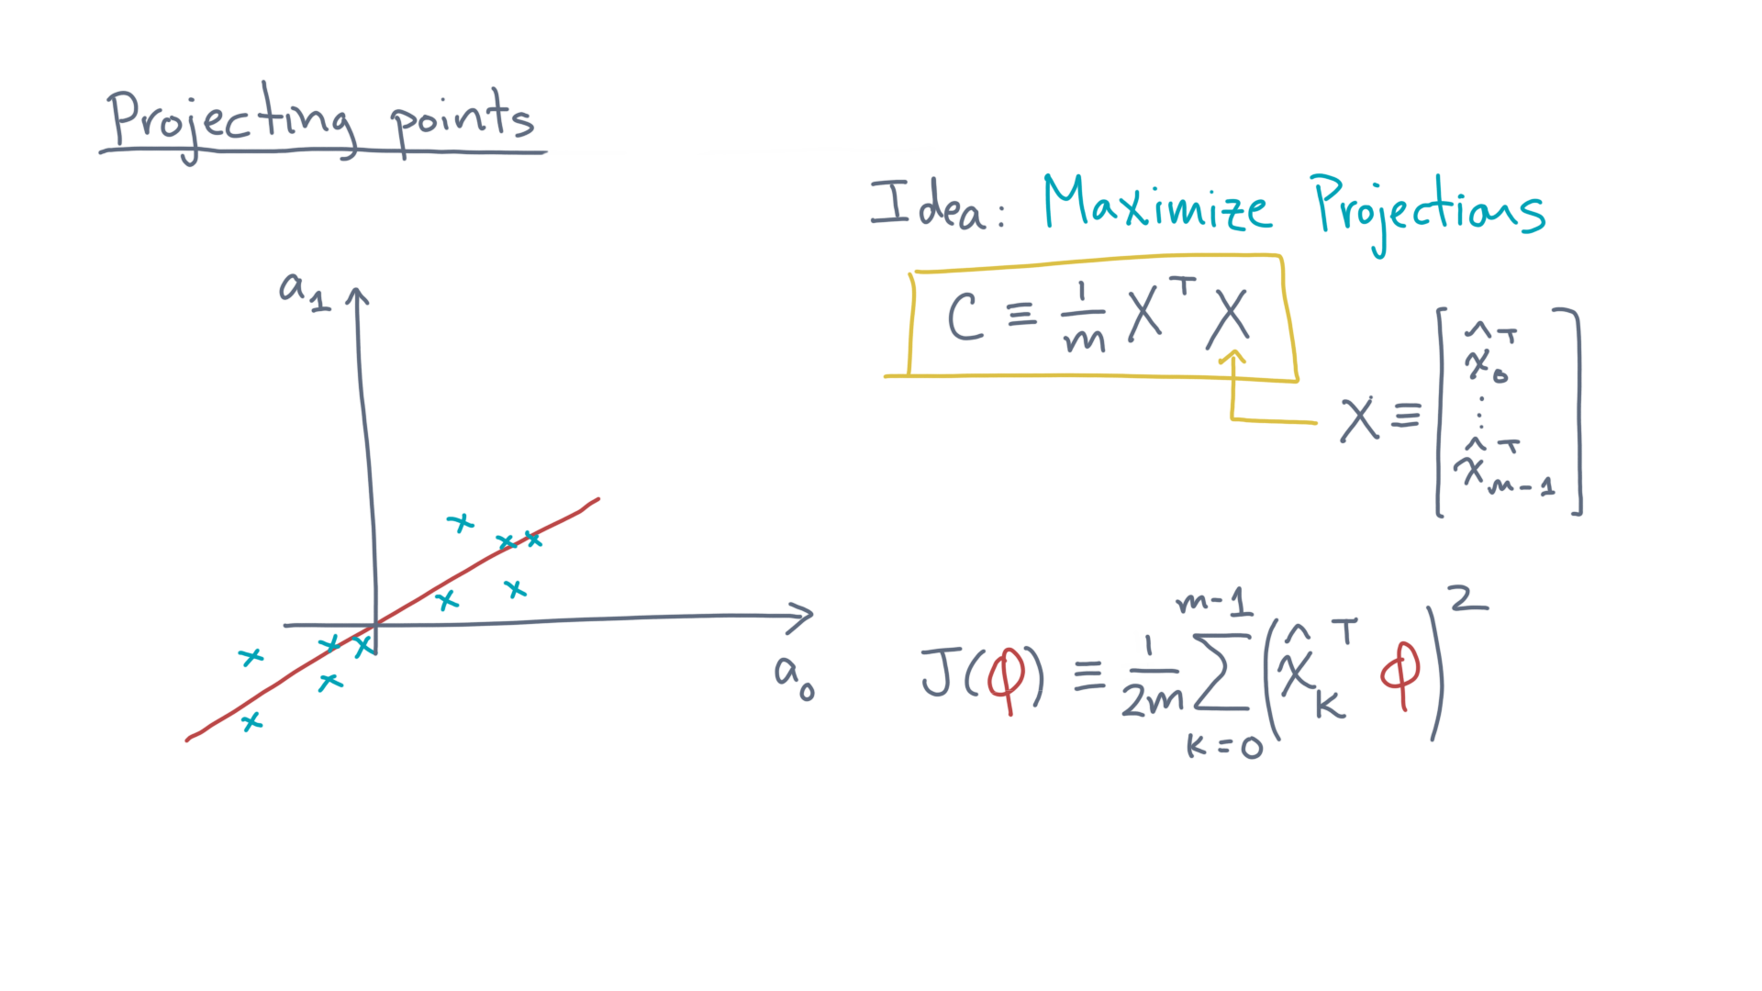
Notes:
Now, let’s define a new matrix, C, equal to one-over-m times X-transpose times X. @TODO: Show
Here, X is our usual data matrix representation, where the observations are the rows.

Slide 29
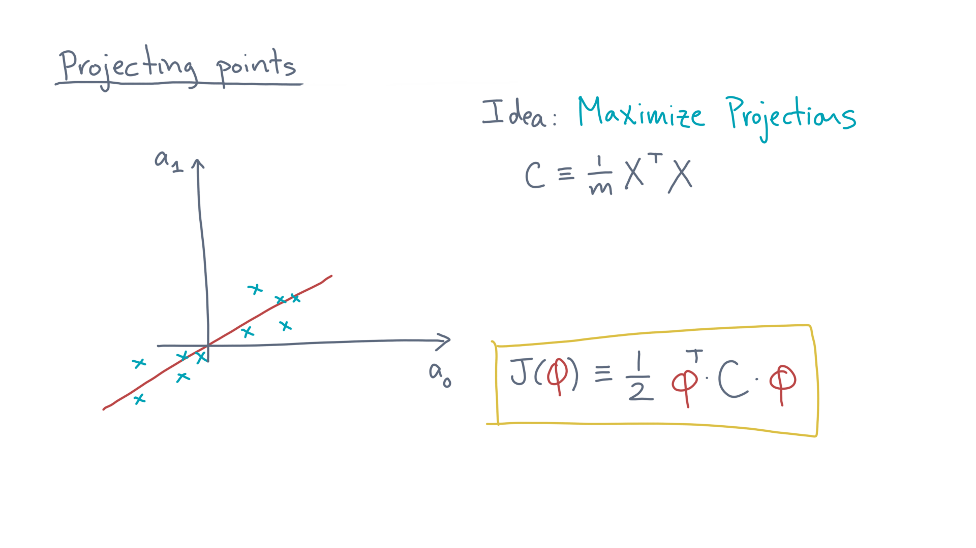
Notes:
You can then show that J(phi) equals one-half phi-transpose times C times phi. @TODO: Show

Slide 30
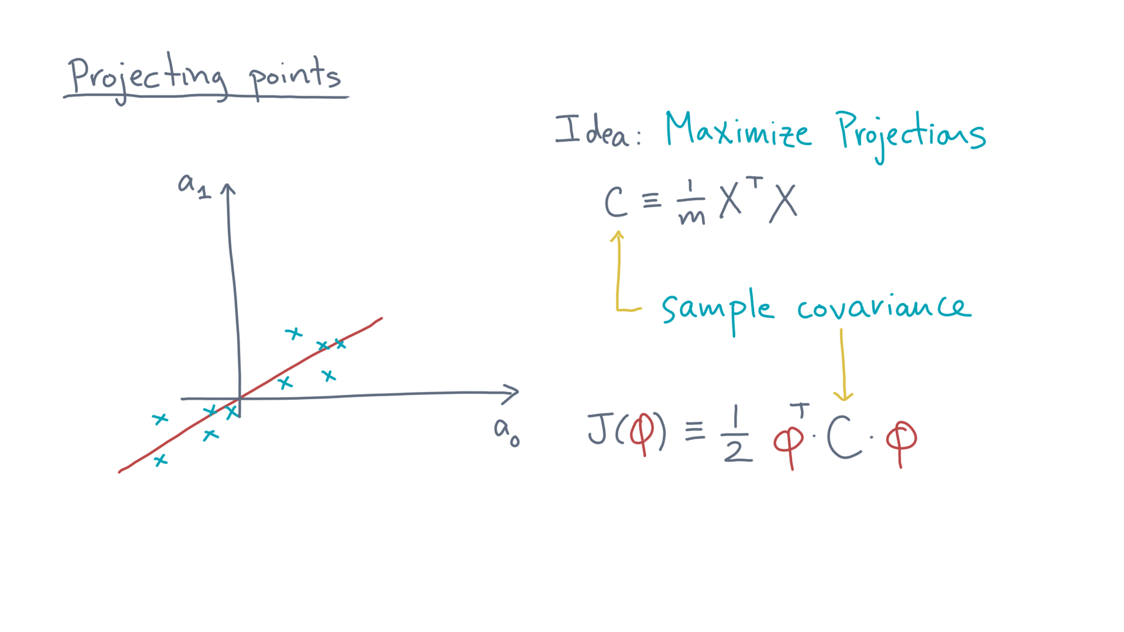
Notes:
You may recognize C as the statistical object known as the sample covariance matrix of the data. @TODO: Show term

Slide 31
Notes:
Okay, I think you’ve done well so far:
We’ve formalized a new problem, which is to find a single axis that maximizes the projections of the original data.

Slide 32
Notes:
I suggest you pause here and do some notebook exercises to give you an intuitive feel for what the math means.
Have fun, and see you in the next lesson, where we try to calculate the optimal solution.

